Slide 1
Computer Simulation
Module 5: Arena
Dave Goldsman, Ph.D.
Professor
Stewart School of Industrial and Systems Engineering
Introduction
Notes:
Module 5.1

Slide 2
Module Overview
Last Module: We looked at general principles behind simulation languages. How do they work?
This Module: We’ll learn about Arena, a popular simulation language.
Idea: Go through a series of tutorials that will allow you to fearlessly simulate real-world systems.

Slide 3
More Overview
This module is built on numerous mini-tutorials.
Many will be self-contained and will focus on a specific topic…
…Yet the tutorials are organized in groups that build to a common goal (e.g., a non-trivial demo).
Each lesson contains written notes, but you must WATCH the videos to see the “live” stuff.

Slide 4
I Gotta Have More Overview!
.
Rough Groupings of Topics:
Introductory material ← now
Modeling multi-channel systems
Building to a call center model
Some demos on interesting miscellaneous models

Slide 5
Pre-Show Notes…
Arena is easy, but if it’s not your cup of tea (whatever reason),…
…There are many other simulation languages around.
Arena is a good choice to enable you to learn those languages.
In any case, we’ll do lots of examples from which you may find useful applications.

Slide 6
The Next Few Lessons
Our first job is to cover some basics:
Process-Interaction ← next
Let’s Meet Arena!
The Arena Basic Template
Create-Process-Dispose Modules
The Process Module
Resources, Schedules, Queues
The Decide Module

Slide 7
Summary
This Time: Discussed what’s coming up in this module on the Arena computer simulation language.
Next Time: A brief review of the Process-Interaction modeling approach. We’ll use this to get our subsequent terminology straight and to re-introduce P-I.

Slide 8
Computer Simulation
Module 5: Arena
Dave Goldsman, Ph.D.
Professor
Stewart School of Industrial and Systems Engineering
Process-Interaction Review
Notes:
Module 5.2

Slide 9
Lesson Overview
Last Lesson: We simply discussed what’s coming up in this Arena module.
This Lesson: A quick review of the Process-Interaction approach that Arena uses.
Idea: It’s just a flowchart!

Slide 10
Process-Interaction
Consider a generic customer (entity) and the sequence of events and activities (processes) it undergoes as it moves through the system.
At any time, the system may have many entities interacting with each other as they compete for resources.
Arena takes this process- interaction “world view.”

Slide 11
P-I (cont’d)
The entities flow through a network of modules (blocks) that describe their behavior.
The network can be represented as a process flowchart.
Example: People show up at the barber, get served (maybe after waiting in line), and then leave.
In Arena:
  Create (generate cust arrivals)
  Process (use the barber)
  Dispose (outta here)

Slide 12
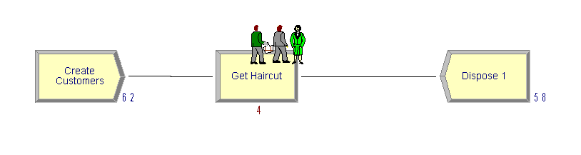
If It Quacks Like a Flowchart…
Wait in line
Generate arrivals
Get Haircut
Outta here!

Slide 13
Summary
This Time: Talked about the Process-Interaction modeling approach and how it relates to Arena.
Next Time: A first look at Arena. How to get it, and a sneak peak.

Slide 14
Computer Simulation
Module 5: Arena
Dave Goldsman, Ph.D.
Professor
Stewart School of Industrial and Systems Engineering
Let’s Meet Arena!
Notes:
Module 5.3

Slide 15
Lesson Overview
Last Lesson: Reviewed the Process-Interaction approach. This is what Arena uses.
This Lesson: Let’s finally meet Arena!
We’ll show how to get the software, and then take a first look.

Slide 16
Getting Arena
Easy to download and install free student version of Arena.
https://www.arenasimulation.com/academic/students
This is a Windows product.
If you’re indeed using Windows, then there is certain Arena stuff you’ll occasionally use that’s stored deep down in a “Rockwell Software” directory (don’t worry about this for now).
If you don’t have Windows, it ain’t a problem…
You can also use Arena via the Georgia Tech virtual labs.
Or you can really be nerdy and partition your disk to use a Windows OS.

Slide 17
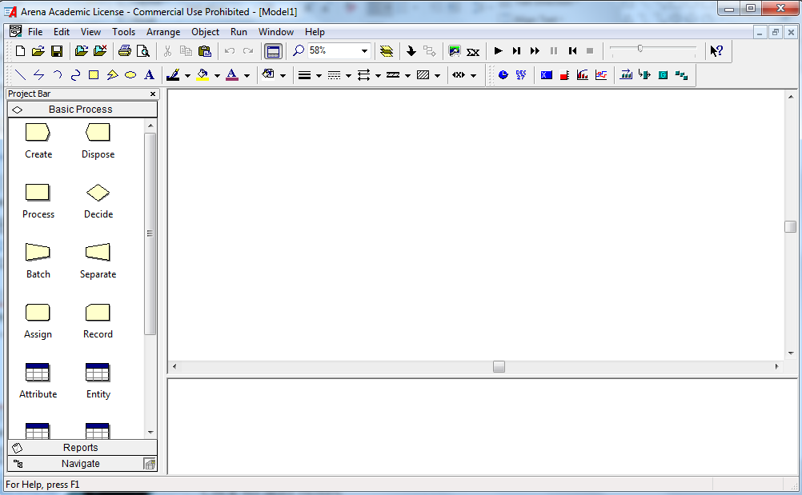
Start Me Up!
Arena screen
This is the main work area.
← This is the template panel, where you get stuff.
You can find certain spreadsheet info here.

Slide 18
File: Lets you do the usual New, Open, Close, Save,…, but also allows you to import different template panels and background pix.
Edit: Allows you to edit entity pix, insert objects, other nice stuff.
View: See various toolbars, customize your “named views”, etc.
Tools: Lots of cool toys, including Input Analyzer, OptQuest, AVI capture, macros,…
Arrange, Object, Window: Various visualization aids.
Run: Set a run up and make it go as fast as you want or step-by-step.

Slide 19
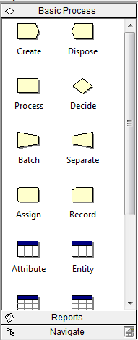
This is the Basic Process template panel.
It does very basic stuff that a Univ. of Georgia student might be able to handle on a good day.
The panel consists of modules (I call ‘em blocks sometimes) such as Create, Dispose, Process, etc., that will be connected together as a flowchart for our simulation model.
The other items such as Attribute, Entity, etc., are related to spreadsheets.
Demo Time! Look at the screen, go buttons, speed, zooming, etc.

Slide 20
Summary
This Time: Finally got to meet Arena! We downloaded Arena and then reviewed what the main screen looks like.
Next Time: We’ll look at the Basic Process template in more detail. The components of this template will allow us to put together our first simulations.

Slide 21
Computer Simulation
Module 5: Arena
Dave Goldsman, Ph.D.
Professor
Stewart School of Industrial and Systems Engineering
Basic Process Template
Notes:
Module 5.4

Slide 22
Lesson Overview
Last Lesson: We were introduced to Arena and went on our first date with it.
This Lesson: We’ll look at the Basic Process template in some detail. The items from this template will allow us to put together our initial simulations.
Idea: Click and drag items to build the simulation.

Slide 23
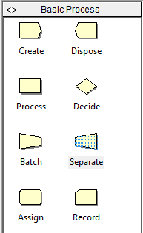
This is the top half of the Basic Process panel.
It does very basic stuff that a Univ. of Georgia student might be able to handle on a good day.
More-advanced templates available for non-UGA students: File > Template Panel > Attach
The panel consists of modules such as Create, Dispose, Process, etc., that will be connected together as a flowchart representation for our simulation model.
Example: Create generates customer arrivals.
You’ll drag these modules over to the work area to build the flowchart, fill in some numbers, and then hit the go button to run the simulation.

Slide 24
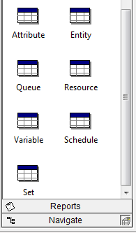
This is bottom half of the Basic Process panel.
These items such as Attribute, Entity, etc., are spreadsheets that are both informational and which will allow us to change certain system parameters.
Example: The Variable spreadsheet defines global quantities such as WIP that are updated as the simulation progresses. Resource keeps track of the names and capacities of the different resources (servers).
Demo Time! Look at a couple of modules and spreadsheets. Load a new template. Build a model.

Slide 25
Summary
This Time: Reviewed the modules and spreadsheets available on the Basic Process template.
Next Time: We’ll learn about the Create, Process, and Dispose modules, and then build our first official simulation.

Slide 26
Computer Simulation
Module 5: Arena
Dave Goldsman, Ph.D.
Professor
Stewart School of Industrial and Systems Engineering
Create-Process-Dispose Modules
Notes:
Module 5.5

Slide 27
Lesson Overview
Last Lesson: Learned about the Basic Process template.
This Lesson: We’ll discuss the Create, Process, and Dispose modules, and then build our first official simulation.
Idea: The modules are easy, but it turns out that there’s a lot going on inside of them.

Slide 28
Create-Process-Dispose
Create: Periodically generate customer arrivals.
Process: Have work performed on the customers; maybe have to wait in line.
Dispose: Customers leave the system after service.
Fun Facts:
  “Dispose” is called “Terminate” in the language GPSS
  “Send to Die” in Automod.

Slide 29
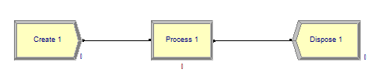
How to Use
Drag and drop from template.
Modules (usually) connect automatically.
Connects are “instantaneous” for customers.
Hit “go” and see guys move…
…But customers don’t look good and no lines form. Be patient and see demos.

Slide 30
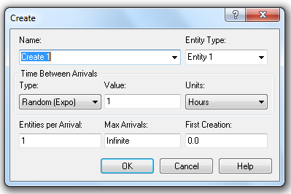
Deeper Dive into Create
Click into modules and see required inputs.
Example: Create
Fields for
  The name of the module
  The type of entity (customer)
  Interarrival distribution
  # of customers per arrival
  Maximum # of arrivals allowed
  Time that the first guy shows up

Slide 31
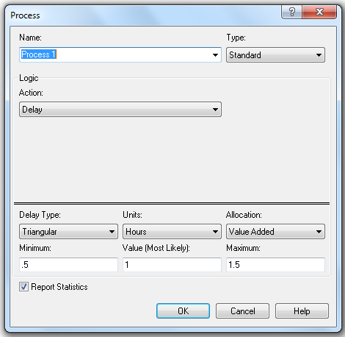
Process and Dispose Modules
Process module has fields for
  The name of the module
  Type of action. This is where you can try to reserve a server or free a server who’s currently in use. More on this in next lesson.
  How long will you be delayed? I.e., what is the service time?
Dispose module
  Nothing deep here – you just get rid of entities.
  You can name the module.

Slide 32
Demo Time!
  Create-Process-Dispose
  Connecting the modules
  Go over input fields
  Expressions and Build Expression
  CONT and DISC functions
  Some other Arena-defined functions

Slide 33
Summary
This Time: Discussed aspects of the Basic Process template’s Create-Process-Dispose modules.
Next Time: Deep dive on the Process module. It does a lot more than you may think!

Slide 34
Computer Simulation
Module 5: Arena
Dave Goldsman, Ph.D.
Professor
Stewart School of Industrial and Systems Engineering
Details on the Process Module
Notes:
Module 5.6

Slide 35
Lesson Overview
Last Lesson: Learned about the Create-Process-Dispose modules.
This Lesson: We’ll learn more goodies about the Process module.
Idea: It allows you to grab servers, use them, and then let them go for the next guy to use. And along the way, it automatically sets up a queue!

Slide 36
Seize-Delay-Release
You’ll take one of the following “actions” in the Process module:
Delay: Spend time in the Process (self-service).
Seize-Delay-Release: Grab at least one resource (server), spend time getting served, and then free the server for the next customer. If you Seize and the server isn’t available, you may have to wait in a queue.
Seize-Delay: Grab at least one resource and spend time getting served. Remember to Release the server sometime later, else he gets deadlocked and a giant line will form!
Delay-Release: Use a previously Seize’d server for a while, and then free him for the next guy to use.
www.youtube.com/watch?v=eAyVgPtC5Zc

Slide 37
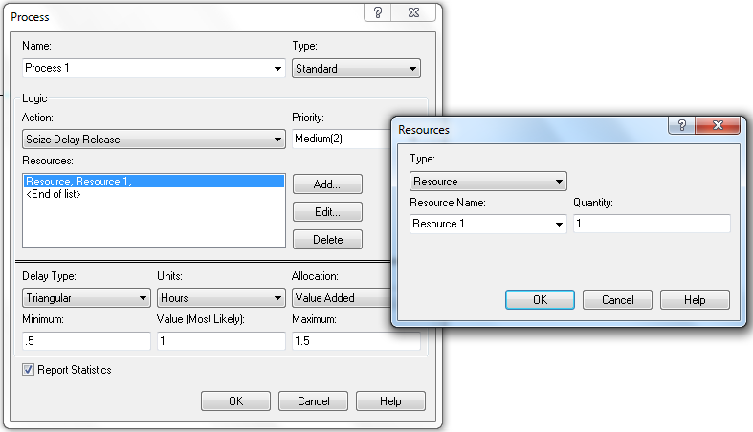
Resource Dialog Box
If you do a Seize or Release, a dialog box pops up asking which and how many resource(s) you want to Add (Seize) or Delete (Release).

Slide 38
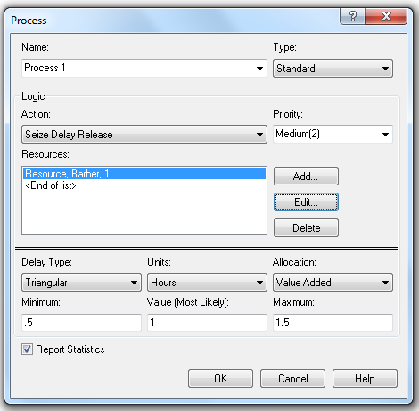
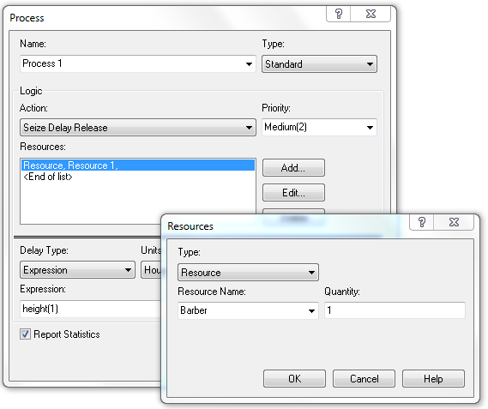
Resource Dialog Box (cont’d)
Example:
A customer walks into the Process module, and does a Seize-Delay-Release to grab and use one unit of the resource Barber.
Hit the Add button, name the resource Barber, and set Quantity = 1.
The Process is given a default name of “Process 1” and includes the resource as well as the default queue “Process 1.Queue” (talk about later).
Process = Resource + Queue

Slide 39
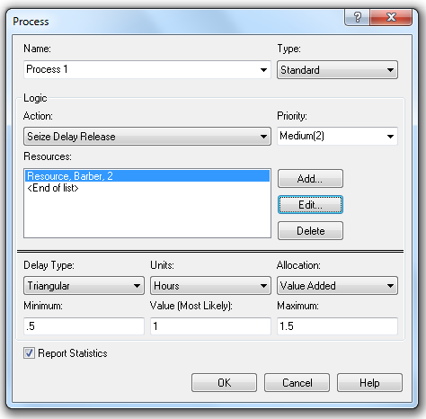
Resource Dialog Box (cont’d)
Slightly Different Example: Now every customer uses TWO barbers. (They all have lots of flowing locks like your gentle teacher). How to do?
Set Quantity = 2 in Add or Edit box.
Distinction: There may be 5 barbers in the store, but each customer needs exactly 2 of them. We’ll show in the next lesson how to use the Resource Spreadsheet to set the Barber’s “capacity” to 5.

Slide 40
Demo Time!
  Different permutations of Seize-Delay-Release
  Notice that a queue magically pops up!
  Multiple resources
  Warning about deadlocks

Slide 41
Summary
This Time: Learned lots more about the Process module, including the Seize-Delay-Release sequence and the associated queue that magically gets set up.
Next Time: We’ll finally take a look at some Arena spreadsheets: Resource, Schedule, and Queue.

Slide 42
Computer Simulation
Module 5: Arena
Dave Goldsman, Ph.D.
Professor
Stewart School of Industrial and Systems Engineering
Resource, Schedule, and Queue Spreadsheets
Notes:
Module 5.7

Slide 43
Lesson Overview
Last Lesson: Talked about the Seize-Delay-Release functionality of the Process module – how do you reserve and use servers?
This Lesson: Now it’s time to look at some of those spreadsheets you may have noticed.
You can change resource capacities, the types of queues, etc.

Slide 44


Resource Spreadsheet
Click on the spreadsheet in the Basic Process template, and you get a list of the resources that the model is using (at the bottom of the screen).
Example: Two resources, Barber and Pedicurist. The resource Barber has fixed capacity 4 (four barbers on duty); there’s only 1 Pedicurist.
Reminder: Capacity is the number of the resource’s servers on duty, not necessarily the number of the servers that a customer requests.
Note: A resource’s servers are regarded as identical and interchangeable.
The resources are automatically sent to the spreadsheet when we define them in the Process module. Or, we can just double-click a new row and define a resource right there in the spreadsheet.
Can change fixed capacity, or make a schedule that varies the capacity over time.

Slide 45


Schedule Spreadsheet
Can set schedules for servers.
Example: Go to the Resource Spreadsheet and change the Type to “Based on Schedule”. The dialog box will change slightly to accommodate a schedule name (which we’ve called “Barber Sched”).
Now go over to the Schedule Spreadsheet and you’ll see that Barber Sched is already there, waiting for your input.
The key is to enter stuff into the “Durations” box.

Slide 46
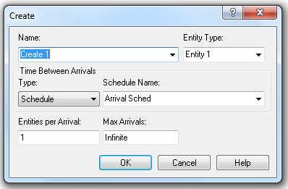

Schedule Spreadsheet
Can set schedules for arrivals.
Example: Go to a Create module and change the Type to “Schedule”. The dialog box will change slightly to accommodate a schedule name (which we’ve called “Arrival Sched”).
Now go over to the Schedule Spreadsheet and you’ll see that Arrival Sched is already there, waiting for your input.
We’ll see in the demo how to enter stuff into the “Durations” box.

Slide 47


Demo Time!
  Resource Spreadsheet
  Resource and Arrival Schedules
  Queue Spreadsheet
  Resource Animation
  Queue Animations

Slide 48
Summary
This Time: Discussed the Resource, Schedule, and Queue Spreadsheets, along with some of their ramifications.
Next Time: We’ll discuss the Decide module, which allows us to make probabilistic and conditional decisions that affect the entities’ paths through the model.

Slide 49
Computer Simulation
Module 5: Arena
Dave Goldsman, Ph.D.
Professor
Stewart School of Industrial and Systems Engineering
The Decide Module
Notes:
Module 5.8

Slide 50
Lesson Overview
Last Lesson: The Resource, Schedule, Queue Spreadsheets
This Lesson: The Decide module, which allows customers to make probabilistic and conditional choices about their paths.
Idea: A flexible module enabling you to go this way and that way!
www.youtube.com/watch?v=z4uWfs3sH7s

Slide 51

Decide Module
When an entity gets to a Decide module, he can…
  Randomly go to either of two locations (“2-way by Chance”) (probabilities are given in percentages)
  Randomly go to any of various locations (“N-way by Chance”)
  Go to either of two locations if a condition is satisfied (“2-way by Condition”)
  Go to any of various locations if a condition is satisfied (“N-way by Condition”)

Slide 52
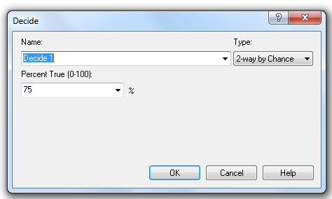
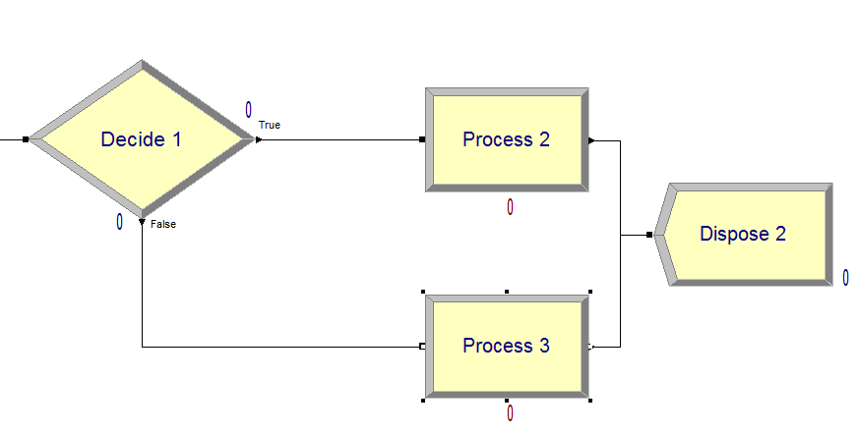
Decide Module
Example: Go to Process 2 with prob 0.75, and Process 3 w.p. 0.25.
Demo Time!
75% this way
25% this way

Slide 53
Summary
This Time: The Decide module, which gives customers lots of choices about moving through the model.
Next Time: The Assign module, which allows us to give values to attributes and variables, and even assign graphics to entities.

Slide 54
Computer Simulation
Module 5: Arena
Dave Goldsman, Ph.D.
Professor
Stewart School of Industrial and Systems Engineering
The Assign Module
Notes:
Module 5.9

Slide 55
Lesson Overview
Last Lesson: The Decide module, which makes probabilistic and conditional decisions about where customers go.
This Time: The Assign module, which allows us to give values to attributes and variables, and even assign graphics to entities.
Idea: Very power, general tool.

Slide 56
The Next Few Lessons
Cover material that’ll eventually allow us to simulate multi-channel customer flows:
The Assign Module ← now
Attribute, Variable, Entity Spreadsheets
Arena Internal Variables
Displaying Stuff
Batch, Separate, Record
Run Setup and Control
Two-Channel Mfg Example

Slide 57
Attributes
Each customer passing through the system has various properties (attributes).
Tom is 6’ tall, weighs 160 lbs, loves baseball, and has LDL cholesterol = 108.
Justin B. is 4’11” tall, weighs 280 lbs, loves eating lard, and has LDL = 543.
Both guys have 4 attributes, though other guys may have different numbers of attributes.
Attributes need to be numerical; for example, BB = 11 and lard = 28.

Slide 58
Variables
Unlike attributes, whose values are specific to each customer, variables are global.
If you change a variable anyplace in the Arena program, it gets changed everywhere.
Example: WIP might be incremented when an entity is Create’d, and decremented if it’s Dispose’d – these events could occur anywhere.

Slide 59

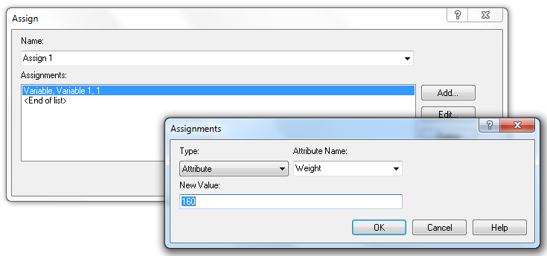
Assign Module
So how can you change attributes, variables, and other stuff?
Use the very powerful and flexible Assign module.
This customer has a weight of 160 lbs

Slide 60
Demo Time!
  Use of Assign for attributes and variables
  Use of Assign for entity pictures
  Using Decide and Assign together

Slide 61
Summary
This Time: Talked about Attributes, Variables, and then the Assign module.
Next Time: The Attribute, Variable, and Entity Spreadsheets.

Slide 62
Computer Simulation
Module 5: Arena
Dave Goldsman, Ph.D.
Professor
Stewart School of Industrial and Systems Engineering
Attribute, Variable, and Entity Spreadsheets
Notes:
Module 5.10

Slide 63
Lesson Overview
Last Lesson: Discussed the Assign module, and how it can be used to (i) give values to attributes and variables, and (ii) change entity graphics.
This Lesson: The Attribute, Variable, and Entity spreadsheets.

Slide 64




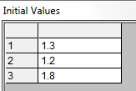

Spreadsheets
The Attribute Spreadsheet keeps track of existing attributes that you might define in an Assign.
Can make your own (double click).
Can be vectorized.
Variable Spreadsheet pretty much the same.
Entity Spreadsheet allows you to set initial picture.
Demo Time!

Slide 65
Summary
This Time: Easy discussion about the Attribute, Variable, and Entity Spreadsheets.
Next Time: We’ll discuss a few Arena “internal” variables that are automatically calculated as the simulation proceeds. These have a great variety of uses.

Slide 66
Computer Simulation
Module 5: Arena
Dave Goldsman, Ph.D.
Professor
Stewart School of Industrial and Systems Engineering
Arena Internal Variables
Notes:
Module 5.11

Slide 67
Lesson Overview
Last Lesson: The Attribute, Variable, and Entity Spreadsheets.
This Lesson: Talk about Arena’s so-called “internal” variables that are automatically calculated as the simulation proceeds.
Idea: Incredibly useful. Help you make decisions based on the simulation’s current state.

Slide 68
Internal Variables
Dirty Little Secret: Arena keeps track of and continuously updates lots of stuff as the simulation runs.
Good for making decisions, drawing graphs, etc.
Examples:
  TNOW = current simulated time
  NR(Barber) = # of resource Barber’s servers now working
  NQ(Process 1.Queue) = # customers in that queue
  Create 1.NumberOut = # of customers who have so far left the module named Create 1
Huge list is available if you sniff around Build Expression.
Demo Time! Go to the shortest line.

Slide 69
Summary
This Time: Introduced internal variables such as TNOW, NR(), etc. They’re constantly updated and provide lots of relevant info.
Next Time: How to display variables, graphs, and results.

Slide 70
Computer Simulation
Module 5: Arena
Dave Goldsman, Ph.D.
Professor
Stewart School of Industrial and Systems Engineering
Displaying Variables, Graphs, and Results
Notes:
Module 5.12

Slide 71
Lesson Overview
Last Lesson: Talked about some useful internal variables that Arena constantly updates.
This Lesson: How can we display the values of certain variables in real time, construct graphs, and produce output result files?

Slide 72


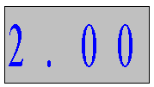
Getting Information
How to display information as the simulation is running?
  Arena provides lots of capability.
  For example, consider the toolbar...
  You can get an analog or digital clock.
  Calendar
  Variable displays, which keep track of the values of variables in real time.
  Histograms
  Graphs
When the simulation is over, it will automatically generate an output report giving info on server usage, queue length, customer waits and cycle times, and other user-defined quantities.
Demo time, including drill press example!

Slide 73
Summary
This Time: Discussed ways to display the values of certain variables in real time, construct graphs, and produce output files.
Next Time: A quick tutorial on the Batch, Separate, and Record modules.

Slide 74
Computer Simulation
Module 5: Arena
Dave Goldsman, Ph.D.
Professor
Stewart School of Industrial and Systems Engineering
Displaying Variables, Graphs, and Results
Notes:
Module 5.12

Slide 75
Lesson Overview
Last Lesson: Talked about some useful internal variables that Arena constantly updates.
This Lesson: How can we display the values of certain variables in real time, construct graphs, and produce output result files?

Slide 76
Getting Information
How to display information as the simulation is running?
  Arena provides lots of capability.
  For example, consider the toolbar...
  You can get an analog or digital clock.
  Calendar
  Variable displays, which keep track of the values of variables in real time.
  Histograms
  Graphs
When the simulation is over, it will automatically generate an output report giving info on server usage, queue length, customer waits and cycle times, and other user-defined quantities.
Demo time, including drill press example!

Slide 77
Summary
This Time: Discussed ways to display the values of certain variables in real time, construct graphs, and produce output files.
Next Time: A quick tutorial on the Batch, Separate, and Record modules.

Slide 78
Computer Simulation
Module 5: Arena
Dave Goldsman, Ph.D.
Professor
Stewart School of Industrial and Systems Engineering
Batch, Separate, and Record Modules
Notes:
Module 5.13

Slide 79
Lesson Overview
Last Lesson: Looked at a bunch of ways to obtain information during and after the run – e.g., histograms, graphs, output reports.
This Lesson: Discuss the Batch, Separate, and Record modules.
These are the last modules for the Basic Process template… We’re making good progress!

Slide 80

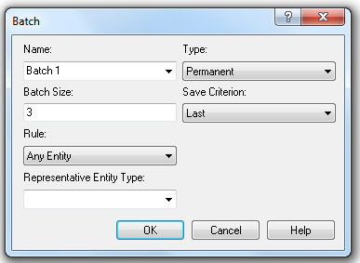
Batch Module
Combine (“batch”) multiple customers into one “super”-customer.
Batch Size = 3 accumulates 3 guys before sending off the super-customer.
If info about the individual customers in a batch won’t be needed later on, then choose Type = Permanent.
But if you want eventually to reconstitute the original members, set Type = Temporary.
Temporary batches will need to be split before being Dispose’d (keep watching).

Slide 81

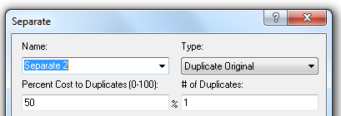
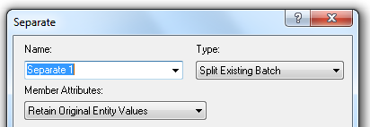
Separate Module
Duplicate a single entity, or split multiple entities that had been combined in a Batch module.
If dealing with a Permanent batch, usually use Duplicate Original to get several customers all with the same attributes.
If dealing with a Temporary batch, use Split Existing Batch to reproduce customers with original attributes.

Slide 82

Record Module
Collect statistics when an entity passes through the module.
We’ll talk more about this module as we encounter it in future examples.
Demo Time! Now we’ll look at a couple of permutations of the Batch and Separate modules.

Slide 83
Summary
This Time: Finished off the Basic Resources template with the Batch, Separate, and Record modules.
Next Time: We’ll look at a bunch of Run Setup and other control functionalities.

Slide 84
Computer Simulation
Module 5: Arena
Dave Goldsman, Ph.D.
Professor
Stewart School of Industrial and Systems Engineering
Run Setup and Control
Notes:
Module 5.14

Slide 85
Lesson Overview
Last Lesson: Finished off the Basic Resources template with the Batch, Separate, and Record modules.
This Lesson: We’ll be looking at a bunch of easy little trivia points to help you get your simulation runs going efficiently.

Slide 86
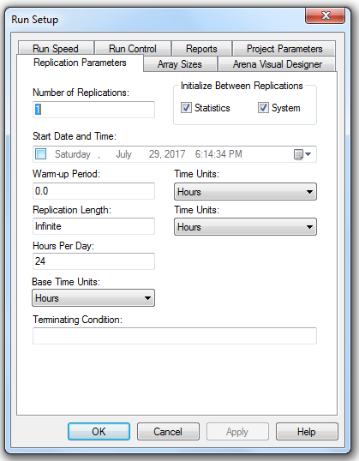
Run Setup
Run > Setup gives you lots of stuff.
Replication Parameters tab
  Number of Reps: # of indep runs.
  Initialize Between Reps: Do you start the stats collection and/or system state from scratch for each replication?
  Warm-up Period: How long to run before you start keeping data.
  Rep Length: How long each run is.
  Terminating Condition: Any special ways to stop the simulation (besides rep length condition from this tab or max arrivals from Create module)?

Slide 87
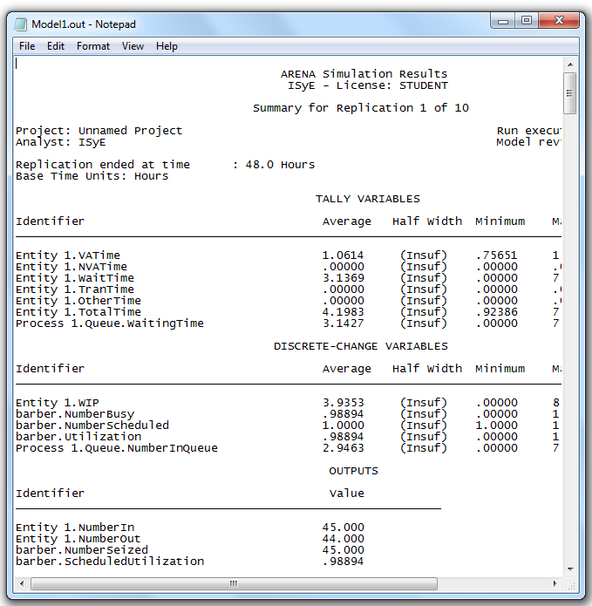
Run Setup (cont’d)
Run Speed tab: Often need to speed up or slow down the simulation by more than what you can do on the main screen.
Reports: Arena has a variety of reports that it gives upon completion of a run.
  Contains info on customer waits, lengths of queues, server utilizations, user-defined variables, etc.
  Category Overview summarizes all reps.
  Category by Replication gives tedious info about each rep.
  SIMAN Report gives concise text file.
SIMAN report

Slide 88
Run Control
Run > Setup > Run Control gives a variety of ways that you can run the simulation.
Example: Batch mode, which turns off all graphics and result in extremely fast runs.
Demo Time! Let’s…
Look at some reports.
Stop the simulation the first time the queue size hits 4.

Slide 89
Summary
This Time: Learned how to do various setup and run control tasks. For instance, we heard about independent reps, run termination from the setup menu, and output reports.
Next Time: A small case study for a two-channel manufacturing system, where we put a lot of the previous material together.

Slide 90
Computer Simulation
Module 5: Arena
Dave Goldsman, Ph.D.
Professor
Stewart School of Industrial and Systems Engineering
Simple Two-Channel Manufacturing Example
Notes:
Module 5.15

Slide 91
Lesson Overview
Last Lesson: Discussed various various run setup and control tasks. E.g., how to implement indep reps, run speed, reports.
This Lesson: Demo a two-channel manufacturing system, where we finally put a lot of the previous material together.
Watch how we use attributes!

Slide 92
The Story
This is Model 4-1 “An Electronic Assembly and Test System” from the KSZ (2015) text, Simulation with Arena.
Two different arrival streams
  Type A parts show up 1-at-a-time; Type B’s 4-at-a-time.
  Type A’s show up a little more often than Type B’s.
A’s feed into a Prep A server; B’s go to Prep B. Different service times.
Then the parts get processed by the same Sealer server, but again with different service time distributions.
All parts undergo an inspection. If they pass, they exit.
If they don’t pass, they go to a Rework server, and then another inspection. Whether or not they pass, they exit the system.

Slide 93
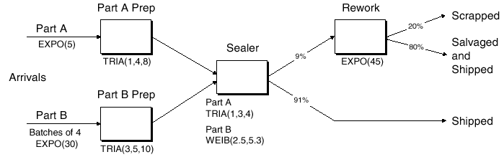
The Story (cont’d)
I stole this flowchart from KSZ…

Slide 94
The Story (cont’d)
How to handle different A and B service times at Sealer?
  Trick 1: Pre-assign the service times as an attribute (Sealer Time) in an Assign module immediately after each customer arrives. Use that attribute regardless of being a Type A or B part.
  Trick 2: While we’re at it, use the Assign to store each customer’s arrival time as an attribute. Use the Arena variable TNOW to do so.
Record departure times just before parts get Dispose’d, This will allow us to get average cycle times (depart – arrival times) for any of the 3 types of parts (pass on first try, pass on second, fail both).

Slide 95
Let’s Get Logical
Dave’s Alternative Trick: Is there another way to model the process time at the Sealer without having to assign a Sealer Time attribute for A’s and B’s?
Yes! It involves a little work, but it’s nice to know.
  Note that the entity types (Part A and Part B) are assigned in the respective Create modules.
  Instead of assigning the Sealer Time as an attribute in the Assign module, we can just wait until the Sealer Process module and use the following logical expression, where (x==y) = 1 if x=y, and 0 otherwise. (See why?)
  ((Entity.Type == Part A) * TRIA(1,3,4)) + ((Entity.Type == Part B) * WEIB(2.5,5.3))

Slide 96
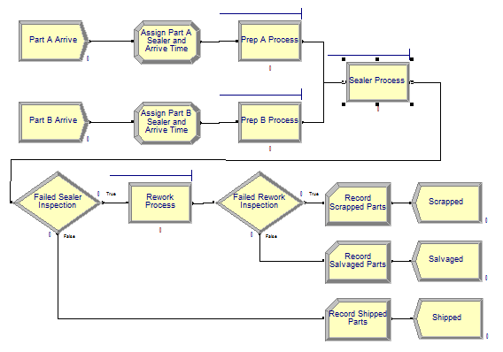
Demo Time!

Slide 97
Summary
This Time: Our first “real” system – a small manufacturing system. Learned a couple of nice tricks involving attributes and logic.
Next Time: Fake Customers!

Slide 98
Computer Simulation
Module 5: Arena
Dave Goldsman, Ph.D.
Professor
Stewart School of Industrial and Systems Engineering
Fake Customers
Notes:
Module 7.16

Slide 99
Lesson Overview
Last Lesson: Demo’d a small electronic assembly and test system.
This Lesson: We’ll talk about “fake” customers!
Idea: These aren’t real customers at all… their purpose is just to do some task that Arena needs.

Slide 100
The Next Few Lessons
We’ll now cover material that will lead us to the simulation of a call center:
Fake Customers ← now
The Advanced Process Template
Resource Failures + Maintenance
The Blocks Template
The Joy of Sets
Description of Call Center
Call Center Demo

Slide 101
Fake Customers
You can use “fake” customers to accomplish various tasks during a simulation.
Not actual customers that you care about in terms of waiting times or use of resources.
Demo Time will explain all!
  Calculate normal probabilities
  Keep track of which time period you’re in (part of Call Center example coming up)
  Breakdown demon

Slide 102
Summary
This Time: Talked about fake customers. We’ll be using these several times in upcoming applications.
Next Time: Now that we’re experts in the Basic Process template, we’ll move on to the Advanced Process template for more good stuff!

Slide 103
Computer Simulation
Module 5: Arena
Dave Goldsman, Ph.D.
Professor
Stewart School of Industrial and Systems Engineering
The Advanced Process Template
Notes:
Module 5.17

Slide 104
Lesson Overview
Last Lesson: Introduced “fake” customers, which can be used for a variety of purposes, including arrivals of breakdown demons.
This Lesson: We’ll add to our arsenal of modules by introducing the Advanced Process template!
Idea: Lots of great new stuff, though I don’t expect you to memorize everything.

Slide 105
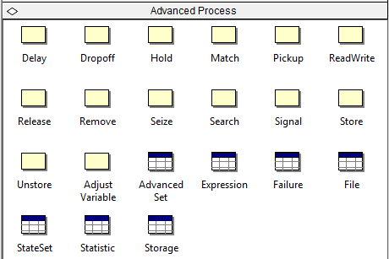
Advanced Process Template
File > Template Panel > Attach (and hopefully you find it in the Rockwell Software \ Arena \ Template directory).
Lots of new modules and spreadsheets.
I don’t expect you to memorize them all.
Concentrate for now on a few of these (comment on others later):
  Seize, Delay, Release modules
  Expression, Failure spreadsheets.

Slide 106
Seize, Delay, Release
Why do we have separate Seize, Delay, and Release modules? Aren’t they right there in the Process module?
Yup, but sometimes you need to do things that are too complicated for the Process module version of Seize–Delay–Release.
Now you can handle things like…
  Seize–Assign–Delay–Release
  Non-symmetric multiple Seize’s and Release’s
  Complicated Seize’s and Release’s that might depend on sets of servers (as in the upcoming Call Center example)
Demo Time!
  Will talk about some of these Seize, Delay, Release issues.
  Will also sneak in some wisdom about the Expression spreadsheet.

Slide 107
Summary
This Time: Learned about the Advanced Process template, which gives us a new bag of tricks to play with!
Next Time: How to deal with resource failures and maintenance.

Slide 108
Computer Simulation
Module 5: Arena
Dave Goldsman, Ph.D.
Professor
Stewart School of Industrial and Systems Engineering
Resource Failures and Maintenance
Notes:
Module 5.18

Slide 109
Lesson Overview
Last Lesson: Learned about the Advanced Process treasure chest.
This Lesson: We’ll study model breakdowns and maintenance in a way that’s more direct than via fake customers.
Idea: It’s just a certain type of schedule!

Slide 110



Failures
You can cause resource failures by scheduling “breakdown demons” (fake customers with high priority). But this isn’t elegant.
Better way is to use the Resource and Failure spreadsheets in conjunction with each other.

Slide 111
Failures (cont’d)
Go to Resource spreadsheet in the Basic Process template.
Click on Failures column.
Add a Failure Name.
Choose Failure Rule (will discuss in a minute).
Go to the Failure spreadsheet in the Advanced Process template, where you’ll see your new failure name.
Choose type of failure:
  Count (failure after a certain # of arrivals)
  Time (after a certain amount of time)
Choose downtime (for repair): Can be any expression.

Slide 112
Remarks
Can schedule multiple failures by using multiple rows of the Failures column in the Resource spreadsheet, e.g., type I failure, type II failure, scheduled maintenance.
Types of Failure Rules:
  Ignore (complete service of current customer, but reduce repair time). E.g., if repair time = 1 hour and cust still needs 10 min, then repair time gets reduced to 50 min and finishes at 60 min mark.
  Wait (complete service of current cust and delay repair). E.g., if repair time = 1 hr and cust needs 10 min, then repair finishes at 70 min mark.
  Preempt (stop service of current cust, but complete service after the repair). Repair stops at 60 min mark, cust finishes at 70 min mark.
Demo Time!

Slide 113
Summary
This Time: How ironic! We succeeded in learning how to implement failures in Arena!
Next Time: A quick intro to the Blocks template, which gives us a kraaAaZy number of new things to look at… but we’ll be very gentle about this.

Slide 114
Computer Simulation
Module 5: Arena
Dave Goldsman, Ph.D.
Professor
Stewart School of Industrial and Systems Engineering
The Blocks Template
Notes:
Module 5.19

Slide 115
Lesson Overview
Last Lesson: Discussed the implementation of resource failures.
This Lesson: We’ll add to our bag of tricks by introducing the Blocks template.
These are lots or blocks in this template, but don’t be intimidated.

Slide 116
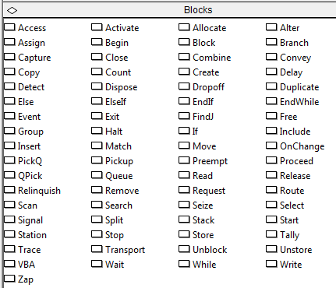
Blocks Template
File > Template Panel > Attach (and hopefully you find it in the Rockwell Software \ Arena \ Template directory).
Huge number of blocks!
Do not be scared!
They’re sort of a self-contained language (related to SIMAN).
Very specialized and low-level.
Very useful, but we’ll only need a few for now:
  Seize, Delay, Release, Queue, Alter

Slide 117
Eh??
Yikes! Why are we seeing stuff like Seize, Delay, Release yet again!? At least two reasons…
  Arena has been built in many layers over the years, and these are what’s left from SIMAN – the “original” incarnation of Arena.
  But in any case, and for whatever reason, certain primitive blocks such as the Queue block can’t even connect to a Seize module from the Advanced Process template or a Process module from the Basic Process template. So you’re stuck!
Demo Time!
  A Queue-Seize-Delay-Release example using primitive blocks (we’ll see this again in the Call Center example coming up).
  Using the Alter block to change the number of resources.

Slide 118
Summary
This Time: The Blocks template! Later on, we’ll find a number of interesting uses for some of these guys.
Next Time: The joy of sets! How to use certain vectorized sets to make modeling easier.

Slide 119
Computer Simulation
Module 5: Arena
Dave Goldsman, Ph.D.
Professor
Stewart School of Industrial and Systems Engineering
The Joy of Sets
Notes:
Module 5.20

Slide 120
Lesson Overview
Last Lesson: Talked about the Blocks template, which we’ll occasionally use to help with specialized little issues.
This Lesson: What are sets, and how do they enhance our modeling ability?
Idea: We’ll especially concentrate on resource sets.

Slide 121
Sets
As in baby math class, a set is just a group of elements. Elements are allowed to belong to more than 1 set.
“Elements” can mean a lot of things in Arena, and so there are various types of sets:
  Resource (e.g., a set of servers)
  Counter
  Tally
  Entity Type
  Entity Picture
  …and tougher stuff later

Slide 122
Resource Sets
Use the Set spreadsheet in the Basic Process template to define sets.
We’ll just study resource sets for now.
A “vanilla” resource has identical, interchangeable servers. But a resource set can have distinct servers, with different schedules, service speeds, service specialties, etc.
Call Center Example: Three products with the following resources
  Product 1: Charity, Noah, Molly, Anna, Sammy
  Product 2: Tierney, Sean, Emma, Anna, Sammy
  Product 3: Shelley, Jenny, Christie, Molly, Anna, Sammy
  Molly, Anna, and Sammy all have degree of cross-functionality.
  All 11 servers turn out to have different schedules (more on that later)

Slide 123
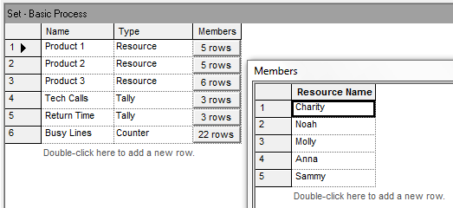
Resource Sets
To define the resource set Product 1, choose Type = Resource, click in Members, then enter Product 1’s servers under Resource Name.
Product 1’s “Preferred Order” is to try Charity first. If she’s not available, try Noah. Save Sammy for last because he’s cross- functional. Other orders are possible.
.

Slide 124


Seize-Delay-Release
Have to be a little careful with Seize-Delay-Release for a resource set.
The problem is that you have to make sure that you Release the same guy that you originally Seize’d. (If you release a random server, some other customer may lose his server!)
Let’s Seize a server from the set Product 1 in Preferred Order. Make sure we remember who it is. Then when we’re done, Release that same guy.

Slide 125
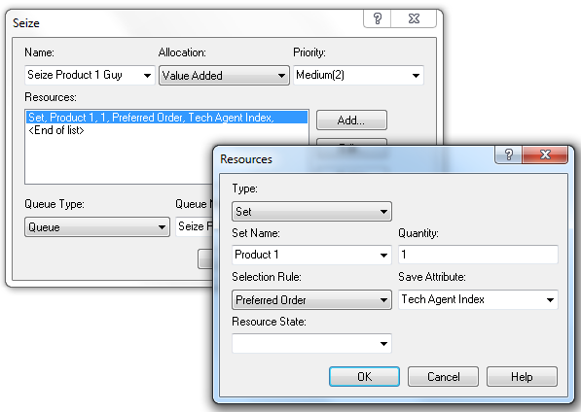
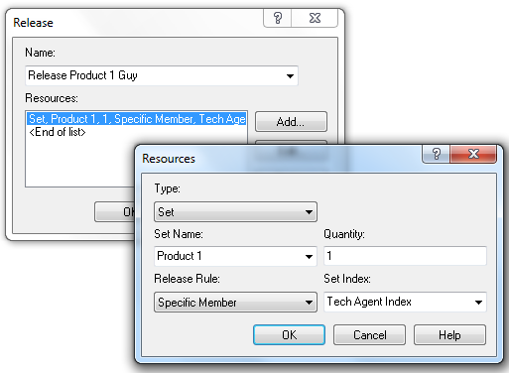
Seize-Delay-Release (cont’d)
Seize Quantity = 1 guy from the set Product 1 in the Preferred Order. Save the “name” of that server in the customer’s Save Attribute called Tech Agent Index.
Later, Release that Specific Member stored in Tech Agent Index.

Slide 126
Remarks
Various Seize Selection Rules are possible:
  Cyclical
  Random
  Preferred Order
  Specific Member
  Largest Remaining Capacity
  Smallest Number Busy
This stuff will be very useful when we do our Call Center example.
Demo Time! A simple model with 4 servers.

Slide 127
Summary
This Time: How joyful! We introduced sets, especially resource sets. Then we showed how to use Seize-Delay-Release with such sets.
Next Time: We’ll describe in Plain English the Call Center example that seems to be all the rage these days.

Slide 128
Computer Simulation
Module 5: Arena
Dave Goldsman, Ph.D.
Professor
Stewart School of Industrial and Systems Engineering
Description of Call Center Example
Notes:
Module 5.21

Slide 129

Lesson Overview
Last Lesson: Mainly discussed resource sets, and how to use Seize-Delay-Release with them. Have to be a little careful.
This Lesson: What we’ve all been waiting for! Let’s start describing the Call Center example.
When we’re done with this, you can be consultants!

Slide 130
Call Center Description
Program is arranged in submodels.
Create and Direct Arrivals
  How often do calls show up and where do they go?
Tech Support Calls
  What kind of tech support do you need?
Returned Tech Calls
  Sometimes the guy has to get back to you.
Sales Calls
Order Status Calls
Time Period Counter – What ½-hour period of the day is it?

Slide 131
Arrivals
Calls show up according to a nonhomogeneous Poisson process.
The center accepts calls from 8:00A till 6:00P.
  The arrival rates change every half hour (see table below from KSZ).
  Also see Arrival Schedule in the Basic Process Schedule spreadsheet.
A few staff actually stay at work until 7:00P, in order to let the calls at the end of the day clear out. (You have to explicitly model 0 arrivals for the last two half-hour segments of the Arrival Schedule.)
Time | Rate | Time | Rate | Time | Rate | Time | Rate
8:00 – 8:30 | 20 | 10:30– 11:00 | 75 | 1:00– 1:30 | 110 | 3:30– 4:00 | 90
8:30– 9:00 | 35 | 11:00– 11:30 | 75 | 1:30– 2:00 | 95 | 4:00– 4:30 | 70
9:00– 9:30 | 45 | 11:30– 12:00 | 90 | 2:00– 2:30 | 105 | 4:30– 5:00 | 65
9:30– 10:00 | 50 | 12:00– 12:30 | 95 | 2:30– 3:00 | 90 | 5:00– 5:30 | 45
10:00– 10:30 | 70 | 12:30– 1:00 | 105 | 3:00– 3:30 | 85 | 5:30– 6:00 | 30
← These rates are per hour (even though time intervals are 30 min)

Slide 132
Phone Lines
There are 26 phone lines. If you get a busy signal, you balk and get killed off.
Use a Queue block with capacity 0 to try to Seize a line. If the Seize fails, there’s no place to go in the Queue, and out you go.
The Queue and Seize both come from the Blocks template panel. This is the only place where you can get a Queue block, and it only connects to this kind of Seize. (Recall that you can also use a Seize within a Process module in the Basic Process template, and there’s another Seize in the Advanced Process template!)

Slide 133
Types of Calls
There are 3 general types of calls, which we’ll handle with an “N-way by Chance” Decide module. Each customer hears a recording for a UNIF(0.1,0.6) amount of time, while he makes his choice of call type.
76% go to Tech Support.
16% go to Sales.
  There are 7 identical, faceless Sales guys that we’ll need to schedule (but not on an individual basis).
  Sales calls take TRIA(4,15,45).
8% go to Order Status.
  Most callers can do self-service in a TRIA(2,3,4) amount of time. But…
  15% of customers need a Sales guy for TRIA(3,5,10).

Slide 134
Tech Support
There are 3 specific types of Tech Support calls (which we’ll again handle via a Decide module):
25% are for Product 1.
34% are for Product 2.
41% are for Product 3.
Each customer gets another recording for a UNIF(0.1,0.5) amount of time, while he makes his choice.
All Tech Support calls require staff for a TRIA(3,6,18) duration of time.

Slide 135
Call Backs
4% of Tech Support calls require additional investigation.
This additional investigation is carried out by another group of staff that we won’t worry about. The customer’s original server is freed up when he makes the determination that more research is needed.
The investigation takes an EXPO(60) amount of time.
At that point, the original Tech Support guy will call the customer back using one of the 26 phone lines (but with high priority).
That call takes TRIA(2,4,9) time.

Slide 136
Tech Support Info
Tech Support staff have some interesting issues.
They all have 8 hr days + 30 min for lunch.
They all have different schedules. We’ll need Resource Schedules to model this on an individual basis.
They all have different product expertise. We’ll need Sets to model this. Here are the Preferred Orders for the sets:
  Product 1: Charity, Noah, Molly, Anna, Sammy
  Product 2: Tierney, Sean, Emma, Anna, Sammy
  Product 3: Shelley, Jenny, Christie, Molly, Anna, Sammy

Slide 137
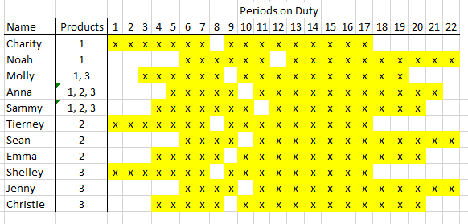
Tech Support Staff Schedules (from KSZ)

Slide 138
Summary
This Time: Gave a long, tedious verbal description of the Call Center model.
Next Time: Gigantic Demo Time! Now we get to see the Arena program in its full glory!

Slide 139
Computer Simulation
Module 5: Arena
Dave Goldsman, Ph.D.
Professor
Stewart School of Industrial and Systems Engineering
Call Center
Notes:
Module 5.22

Slide 140
Lesson Overview
Last Lesson: Plain English description of the Call Center model, along with some Arena details (but no actual demo).
This Lesson: It’s Demo Time!
Idea: We’re putting together ideas from many of the recent lessons. Everything from fake customers to resource sets.

Slide 141
Be On The Lookout
As we go thru the model, keep an eye out for some interesting things…
Submodels
Fake customers used as timers
Use Queue with capacity 0 to kick out callers getting busy signal
NHPP arrivals
3 resource sets for Tech Support
Tricky Seize-Delay-Release
Quirky callback procedure
Demo Time!

Slide 142
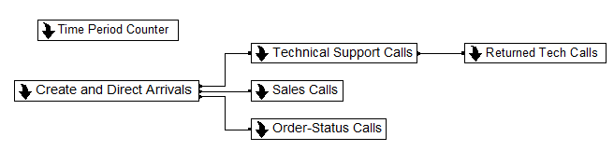
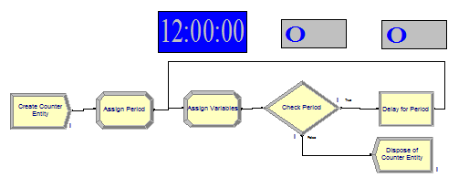
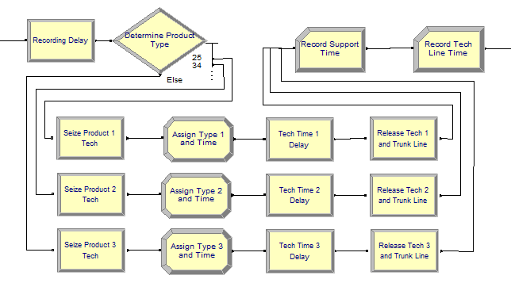
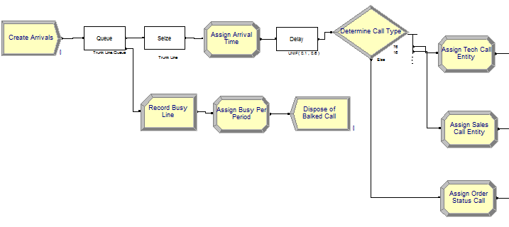
Top-Level View
Time Period Counter
Tech Support Submodel
Arrivals Submodel

Slide 143
Summary
This Time: We put together a lot of stuff and finally demo’d the Call Center example in all of its radiant glory.
Next Time: We’ll describe an Inventory system in Plain English before doing an analogous demo.

Slide 144
Computer Simulation
Module 5: Arena
Dave Goldsman, Ph.D.
Professor
Stewart School of Industrial and Systems Engineering
An Inventory System
Notes:
Module 5.23

Slide 145
Lesson Overview
Last Lesson: Call Center simulation demo.
This Lesson: Plain English description of simple Inventory system and then a demo.

Slide 146
The Next Few Lessons
We’ll now look at several demos.
An Inventory Model ← now
One Line vs. Two Lines?
A Re-entrant Queue
SMARTS files and Rockwell demos
A Manufacturing System (with transporters, conveyors, …)

Slide 147
Description of (s,S) Policy
Simulate the widget inventory stock over time.
Use modules from the Basic and Advanced panels.
Customer interarrivals are EXPO(0.1).
Demand size is a DISC function.
Demand is always “met” (backlogged, if necessary).
Inventory is “taken” at the start of each day.
If inventory is below s, we order up to S.
Delivery lead time is UNIF(0.5,1) before order arrives (pretty quick, but by the time it arrives, other customers will have arrived).
Order costs (set-up + incremental), holding costs, penalty costs.

Slide 148
Description (cont’d)
Calculate average total cost per day over 120 days.
Inventory, unit costs, and all of the other parameters are variables.
Inventory is decremented by demands, incremented by orders.
Interarrival times, demands, lead time, are expressions from Advanced Process template.
Accumulated costs are calculated in the Statistic spreadsheet in the Advanced panel.
Daily inventory review is conducted by a “fake” customer.
Demo Time!

Slide 149
Summary
This Time: Discussed and demo’d a nice little (s,S) inventory policy.
Next Time: One Line, Two Lines, Red Line, Blue Line?
https://www.youtube.com/watch?v=yauPbZKzChs

Slide 150
Computer Simulation
Module 5: Arena
Dave Goldsman, Ph.D.
Professor
Stewart School of Industrial and Systems Engineering
One Line vs. Two Lines?
Notes:
Module 5.24

Slide 151
Lesson Overview
Last Lesson: We worked on an (s,S) inventory policy example.
This Lesson: Should we use one line feeding into two parallel servers or separate lines feeding into two individual servers?
Idea: We’ll use a very cool trick called common random numbers to do an apples-to-apples comparison.

Slide 152
Game Plan
Option A: Customers show up and join one line in front of two identical servers. They go to whichever server is available first.
Option B: Customers randomly choose which of two lines (in front of single servers) to join.
Will compare which of A or B is better by using:
  The exact same customer arrivals (thanks to a Separate module), and
  The same service times for a particular customer whether or not he’s doing A or B (thanks to an early Assign module).
Almost certainly, Option A is better (why?)
Matching up the arrival and service times makes things easier for us statistically. “Common Random Numbers”

Slide 153
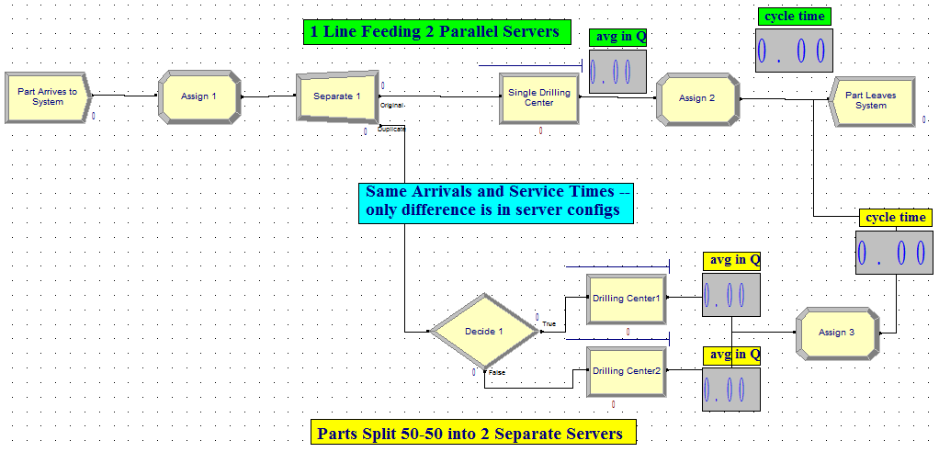
And now… it’s Demo Time!

Slide 154
Summary
This Time: Used Arena to compare two different server configurations for a simple queueing system.
Next Time: We’ll look at a kraaAaZy re-entrant queueing system. Very non-intuitive, very kool. Simulation was the first way people used to analyze these things.

Slide 155
Computer Simulation
Module 5: Arena
Dave Goldsman, Ph.D.
Professor
Stewart School of Industrial and Systems Engineering
A Crazy Re-entrant Queue
Notes:
Module 5.25

Slide 156
Lesson Overview
Last Lesson: We compared different queueing strategies – one line vs. two lines.
This Lesson: A more-interesting system – a re-entrant queue.
Idea: If you re-use servers and mess around with priorities, you can get some pretty non-intuitive outcomes!

Slide 157
Re-entrant Queues
Customers go to Server 1, then to Server 2, then back to Server 1, back to 2, and finally back to 1. That is, 1 → 2 → 1 → 2 → 1.
  These returns are why we call the queues “re-entrant”.
  They’re depicted in Arena as 5 separate Process modules with Seize-Delay-Release trios. (It’s OK to Seize the same server in different Process modules.)
This seems like a perfectly boring model. Let’s make it interesting.
  All service times are exponential. Here are the means:
  1 (0.1) → 2 (0.5) → 1 (0.1) → 2 (0.1) → 1 (0.5)
  …and the customer priorities:
1 (low) → 2 (high) → 1 (medium) → 2 (low) → 1 (high)
  Thus, on the customer’s 3rd visit to Server 1, he has a high-priority EXPO(0.5) service time.

Slide 158
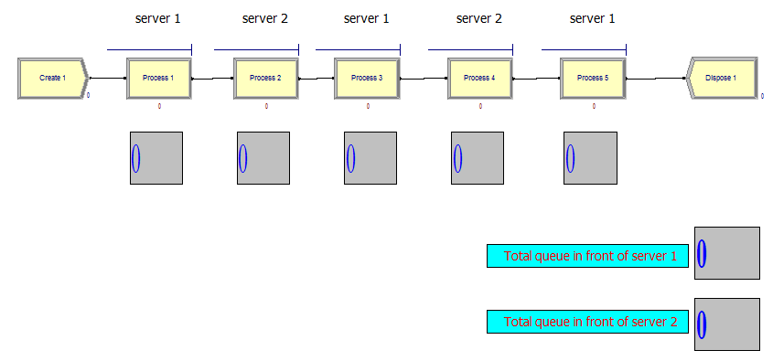
Get ready for… Demo Time!
You’re gonna see mind-blowing behavior!

Slide 159
Summary
This Time: So cool, so very cool. Words escape me.
Next Time: We’re going to get smart… literally!
SMARTS files! ☺

Slide 160
Computer Simulation
Module 5: Arena
Dave Goldsman, Ph.D.
Professor
Stewart School of Industrial and Systems Engineering
SMARTS and Rockwell Files
Notes:
Module 5.26

Slide 161
Lesson Overview
Last Lesson: Re-entrant Q’s and phenomenal behavior!
This Lesson: Rockwell has hidden away some beautiful little gems: SMARTS files and demos.
Idea: These make great bedtime reading.

Slide 162
SMARTS + Rockwell Demos
SMARTS: Very nice tutorial files organized by subject area.
  E.g., there’s a SMARTS file to create customers with a time-dependent arrival rate that varies according to an equation (an expression).
  100s of SMARTS files
Rockwell has also prepared many professional demos.
Libraries > Documents > Rockwell Software > Arena
Some Typical Examples that we’ll demo:
  SMARTS - Arrivals Varying Rate via Expression
  SMARTS - Queues Evaluate Conditions Before Proceeding
  Rockwell Emergency Room
  Rockwell Mission to Mars
Demo Time!

Slide 163
Summary
This Time: Looked at several Rockwell SMARTS and demo files.
Next Time: We’ll demo a easy-looking yet fairly sophisticated manufacturing cell, along with a couple of variations involving transporters and conveyors.

Slide 164
Computer Simulation
Module 5: Arena
Dave Goldsman, Ph.D.
Professor
Stewart School of Industrial and Systems Engineering
A Manufacturing System
Notes:
Module 5.27

Slide 165
Lesson Overview
Last Lesson: Cool SMARTS and Rockwell demos.
This Lesson: We’ll demo a easy-looking yet fairly sophisticated manufacturing cell, along with a couple of variations involving transporters and conveyors.
Idea: Introduce movement and multiple part paths. Extremely useful stuff that generalizes!

Slide 166
Description
Manufacturing cell with 3 types of parts.
Each part type follows a different path (“sequence”) thru the system.
  Different service times at each station (depending on part type and place in visitation sequence).
  E.g., Part type 2’s visit stations 1 > 2 > 4 > 2 > 3, each with different service times.
Movement requires the Advanced Transfer template
  Route, Station, Enter, Leave modules
  Sequences spreadsheet
  “Advanced Sets” (which is where the sequences come in).
Parts can move in a variety of ways:
  By themselves, transporters, conveyors.
  Requires construction of transporter and conveyor paths

Slide 167
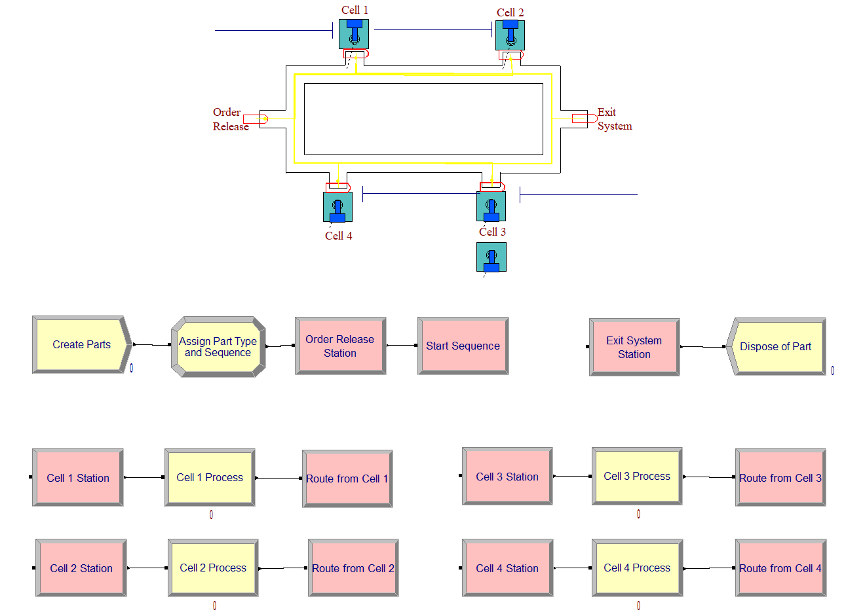
Demo Time!

Slide 168
Summary
This Time: We did demos on a small, yet sophisticated manufacturing cell, along with some variants involving movement.
This ends our module on Arena.
We’ll still see Arena later on.
We only scratched the surface.
Next Time: An entire module on generating Unif(0,1)’s!!!

Slide 170
Computer Simulation
Module 5: Arena
Dave Goldsman, Ph.D.
Professor
Stewart School of Industrial and Systems Engineering
A Manufacturing System in Detail
Part 1. Introduction + Advanced Transfer Panel
Notes:
Module 5.28

Slide 171
Coming Up…
A bunch of additional lessons related to our Manufacturing Example!
Advanced Transfer Panel Modules related to movement
  Station, Route, Enter, Leave
Sequences of visitation locations
Sets and Advanced Sets (e.g., sets of Sequences)
Detailed walk-through of the model
Parts can move in a variety of ways:
  By themselves
  Via transporters
  Via conveyors
  Requires construction of transporter and conveyor paths

Slide 172
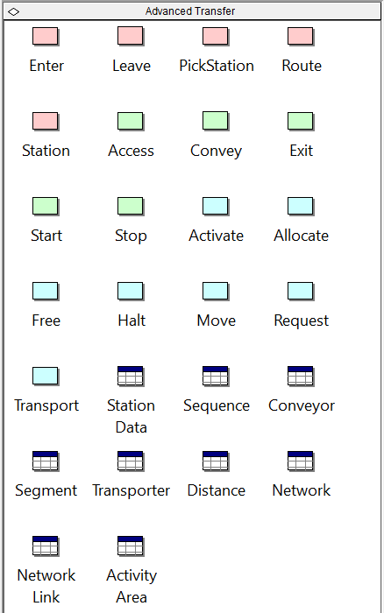
Advanced Transfer
An entire panel related to movement
This Lesson: Where you move
  Station: Somewhere you can go to
  Route: Tells you where you’re going. Similar to Connect, except it takes time
  Enter: General way to get into a Station
  Leave: General way to depart a Station
Subsequent Lessons: How you move
Mini-Demo with Station and Route!

Slide 173
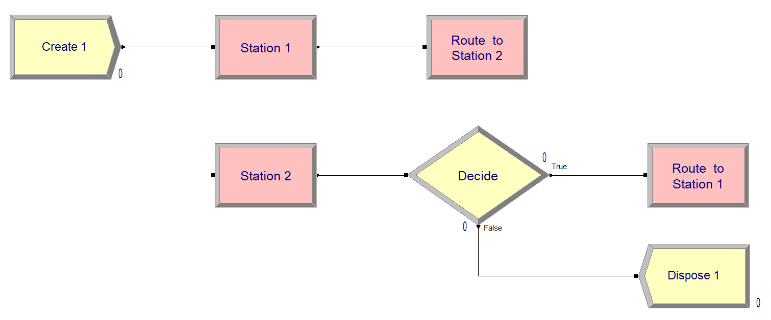

Slide 174
Computer Simulation
Module 5: Arena
Dave Goldsman, Ph.D.
Professor
Stewart School of Industrial and Systems Engineering
A Manufacturing System in Detail
Part 2. Sequences
Notes:
Module 5.29

Slide 175
Coming Up…
A bunch of additional lessons related to our Manufacturing Example!
Advanced Transfer Panel Modules related to movement
  Station, Route, Enter, Leave
Sequences of visitation locations
Sets and Advanced Sets (e.g., sets of Sequences)
Detailed walk-through of the model
Parts can move in a variety of ways:
  By themselves
  Via transporters
  Via conveyors
  Requires construction of transporter and conveyor paths

Slide 176
Sequences
Each type of customer follows a different path (sequence) thru the system.
  A sequence goes from station to station
  Maybe have different service time distribution at each station (depending on customer type and place in visitation sequence).
Example:
  Part Type 1’s visit stations 1 > 2 > 3 > 4
  Part Type 2’s visit 1 > 2 > 4 > 2 > 3
  Part Type 3’s visit 2 > 1 > 3
  Each with different service times distributions

Slide 177
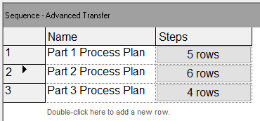
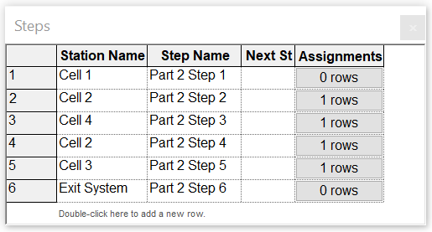
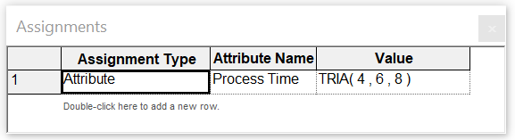
Defining Sequences and Assigning Attributes
Three different Sequences
Part Type 2 Sequence
Type 2 Process Time at Cell 2
Demo Time!

Slide 178
Computer Simulation
Module 5: Arena
Dave Goldsman, Ph.D.
Professor
Stewart School of Industrial and Systems Engineering
A Manufacturing System in Detail
Part 3. Advanced Sets
Notes:
Module 5.30

Slide 179
Coming Up…
A bunch of additional lessons related to our Manufacturing Example!
Advanced Transfer Panel Modules related to movement
  Station, Route, Enter, Leave
Sequences of visitation locations
Sets and Advanced Sets (e.g., sets of Sequences)
Detailed walk-through of the model
Parts can move in a variety of ways:
  By themselves
  Via transporters
  Via conveyors
  Requires construction of transporter and conveyor paths

Slide 180
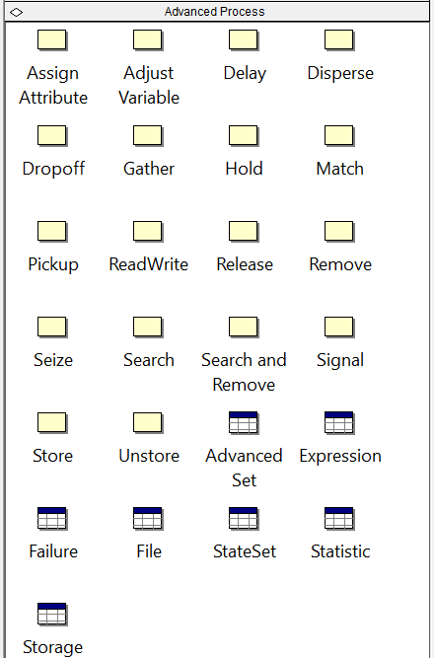
Advanced Sets
Found in Advanced Process panel
Used for kraaAaZy types of sets, e.g., sets of sequences!
Our Advanced set will be called Part Sequences, and will consist of the “elements” (sequences):
{Part 1 Process Plan, Part 2 Process Plan,
Part 3 Process Plan}
Think of Part Sequences as a vector,
Part Sequences(2) = Part 2 Process Plan
Mini-Demo!

Slide 181
Computer Simulation
Module 5: Arena
Dave Goldsman, Ph.D.
Professor
Stewart School of Industrial and Systems Engineering
A Manufacturing System in Detail
Part 4. Model Walk-Through
Notes:
Module 5.31

Slide 182
Coming Up…
A bunch of additional lessons related to our Manufacturing Example!
Advanced Transfer Panel Modules related to movement
  Station, Route, Enter, Leave
Sequences of visitation locations
Sets and Advanced Sets (e.g., sets of Sequences)
Detailed walk-through of the model
Parts can move in a variety of ways:
  By themselves
  Via transporters
  Via conveyors
  Requires construction of transporter and conveyor paths

Slide 183
Description
Manufacturing cell with three types of parts.
Each part type follows a different path (“sequence”) thru the system.
  Different service times at each station (depending on part type and place in visitation sequence).
  E.g., Part Type 2’s visit stations 1 > 2 > 4 > 2 > 3, each with different service times.
Movement requires the Advanced Transfer template
  Route, Station modules (will look at Enter and Leave modules later)
  Sequences spreadsheet
  Advanced Sets (which is where the sequences come in).
Service times usually handled in Sequence definitions (except Cell 1)
Cell 3 has two servers: An old slow guy, and a young 20% faster guy

Slide 184
Demo Time!

Slide 185
Computer Simulation
Module 5: Arena
Dave Goldsman, Ph.D.
Professor
Stewart School of Industrial and Systems Engineering
A Manufacturing System in Detail
Part 5. Transporters and Conveyors
Notes:
Module 5.32

Slide 186
Coming Up…
A bunch of additional lessons related to our Manufacturing Example!
Advanced Transfer Panel Modules related to movement
  Station, Route, Enter, Leave
Sequences of visitation locations
Sets and Advanced Sets (e.g., sets of Sequences)
Detailed walk-through of the model
Parts can move in a variety of ways:
  By themselves
  Via transporters
  Via conveyors
  Requires construction of transporter and conveyor paths

Slide 187
Other Ways to Move
We’ll look at ENTER – LEAVE modules for Station-to-Station movement.
Different way you can travel, via…
Resource (e.g., an assistant)
  Seize-Release
Transporter (e.g., a car)
  Request-Free
  Requires Distance Set
Conveyor
  Access-Exit
  Requires Segment Set
Demo Time!

Slide 188
Summary
Last Few Lessons: We discussed in detail a small, yet sophisticated manufacturing cell, along with some variants involving movement.
This ends our module on Arena.
We’ll still see Arena later on.
We only scratched the surface.
Next Time: An entire module on generating Unif(0,1)’s!!!

